Slide 1
ParWave: Simulating Wave-Particles in Parallel
Gohar Irfan, Apostolos Kokolis and Saad Hussain

Slide 2
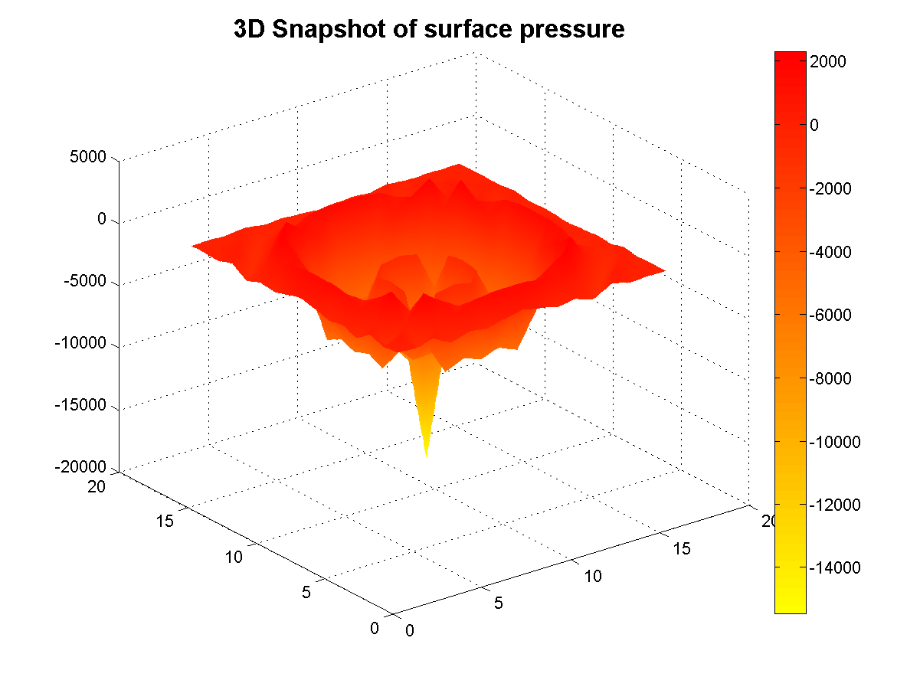
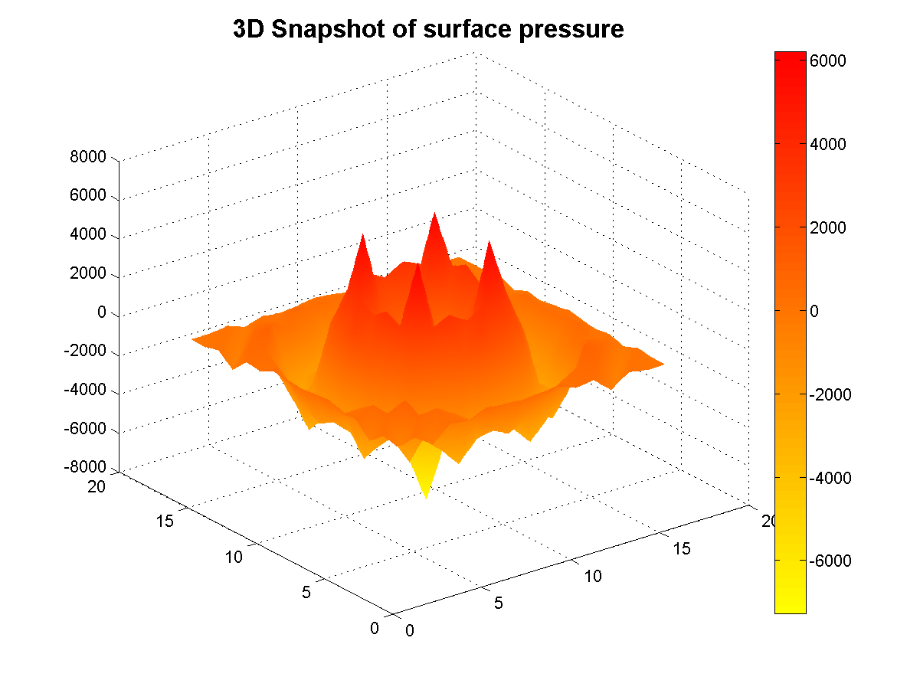
Introducing a pebble in the fluid body...

Slide 3
Wave Equation
Pressure p at location i,j at time t+1:

Slide 4
Particle Movement
At each iteration:
Check for the lowest pressure location among neighbours
Move particles to that location

Slide 5
Particle Motion
36.12 | 10.56 | 11.78
41.22 | 15.43 | 7.13
14.78 | 12.78 | 13.25

Slide 6
Particle Motion
36.12 | 10.56 | 11.78
41.22 | 15.43 | 7.13
14.78 | 12.78 | 13.25

Slide 7
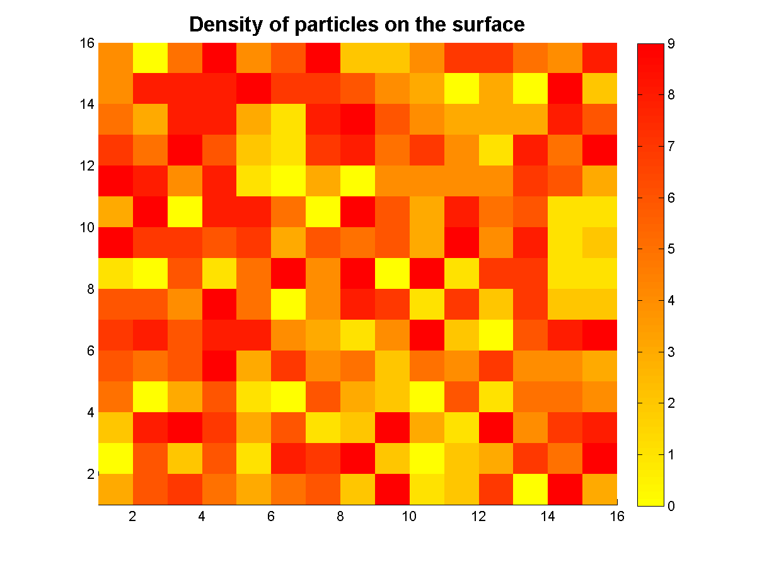
What happens to the particles?

Slide 8
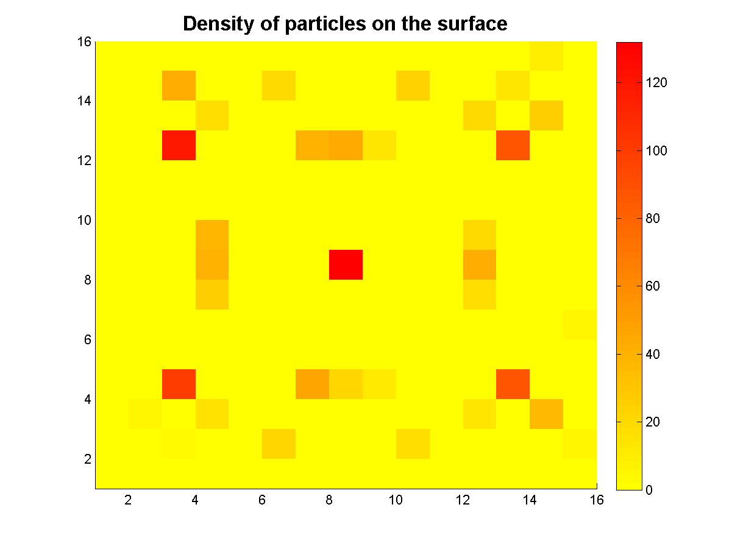
What happens to the particles?

Slide 9
Implementations
We investigated 6 different implementations:
Serial
PThread
OpenMP
MPI
Hybrid
CUDA

Slide 10
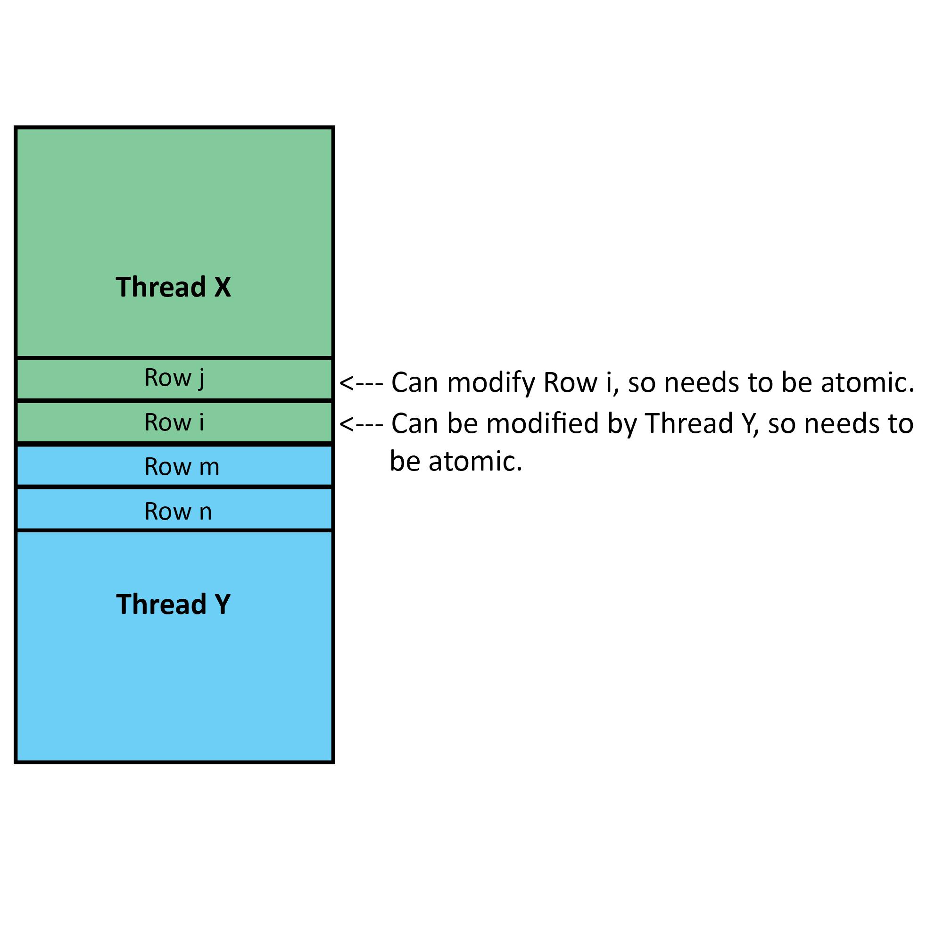
OpenMP / PThreads
The goal is to:
minimize the use of atomic directives
row decomposition of the matrix => atomics only for the neighbouring rows
use of two barrier for synchronization

Slide 11
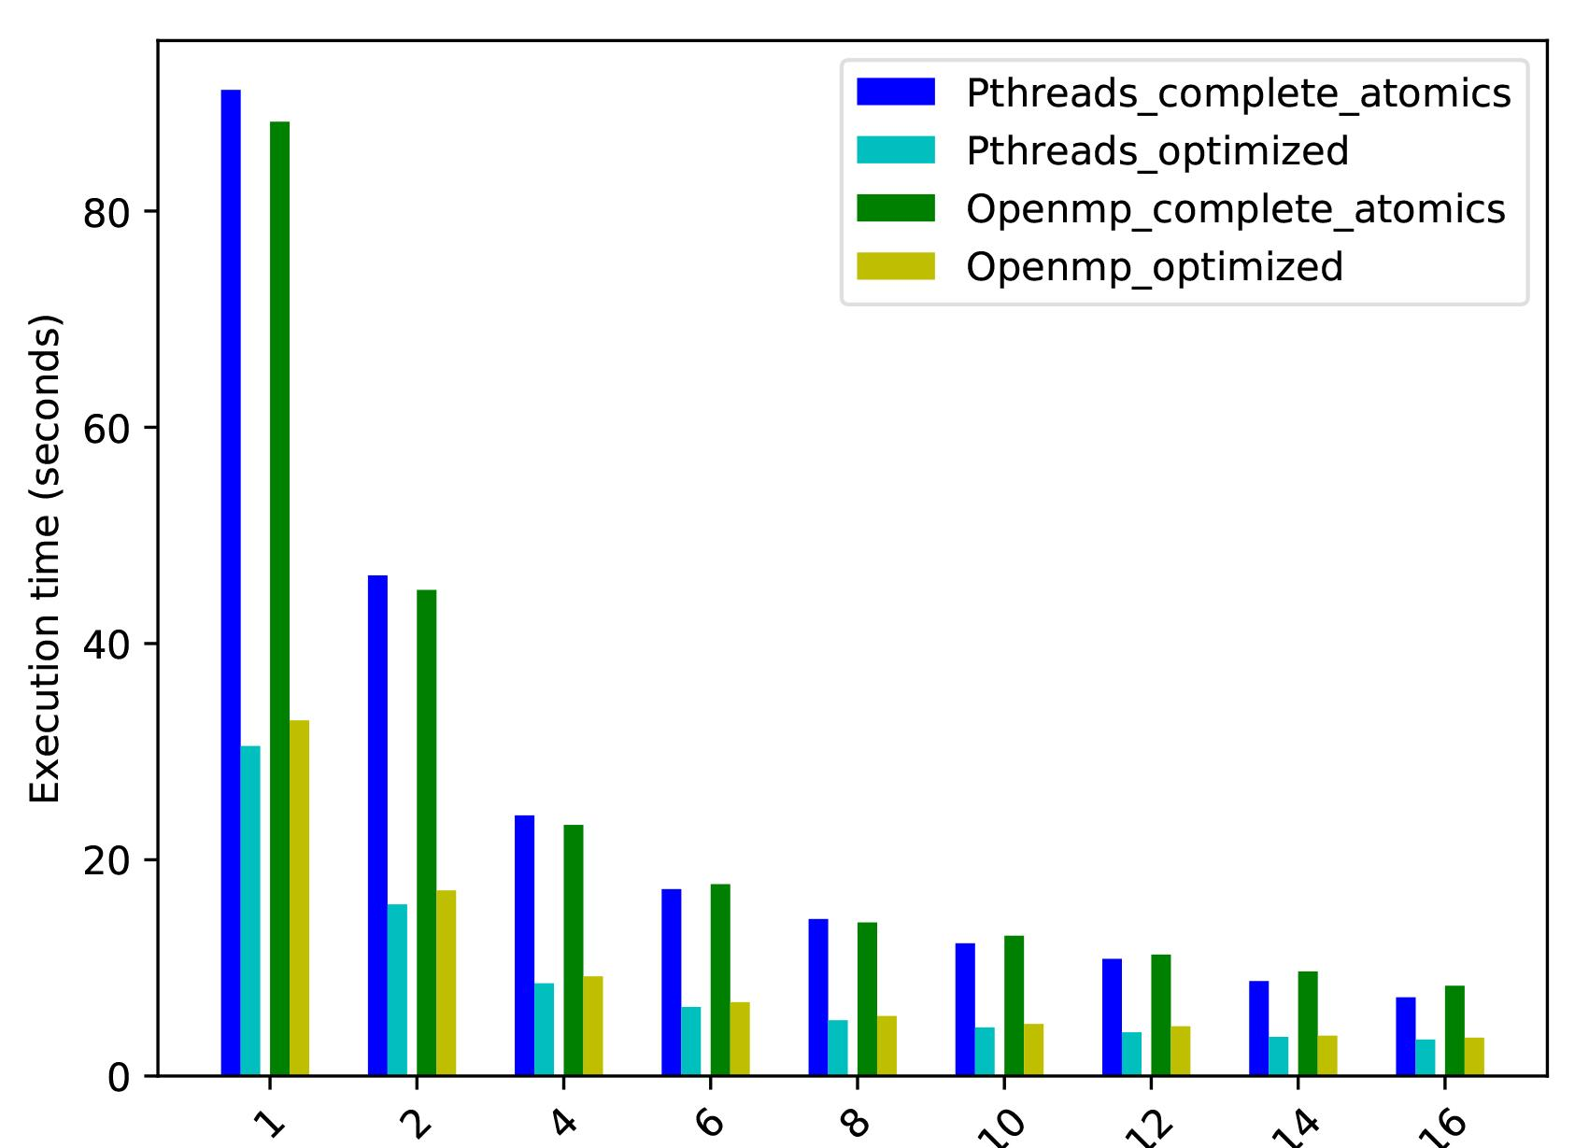
Atomic Optimization

Slide 12
MPI Implementation
Split the work in tiles => better Isoefficiency
Initialize at master thread and scatter to everyone
We declared our own datatypes for exchanging messages, scattering and gathering
Communicate with up to 4 neighbouring tiles for the ghost cells
Particles might move from one tile to another

Slide 13
MPI Implementation
Pros
Scales to more nodes
no use of atomics - separate address space per process
Cons
Need for communication
Synchronising for communication exposes load imbalance
More difficult to program

Slide 14
Hybrid MPI/OpenMP
Combination of MPI and OpenMP
Tile decomposition for the MPI
Row decomposition within the tile for the OpenMP => reduce atomics
Results show that it can be more efficient

Slide 15
Hybrid MPI/OpenMP
Pros
Scales to more nodes
Fewer messages for the same level of parallelism (threads*processes)
Cons
Needs two distinct programming models => increased programming complexity

Slide 16
CUDA
Two implementations:
Non-Tiled; each thread computes pressure and particles for one location
Tiled; each thread block computes a tile of pressure points and particles

Slide 17
CUDA (Non-Tiled)
Pros
Easier to implement
Cons
Too many threads
Less amount of work for each thread
High kernel launch overhead compared to the amount of work
Redundant global memory accesses
Application becomes memory bound

Slide 18
Cuda (Tiled)
Pros
Using shared memory
Each thread in a block collaborates in loading a tile of data
No redundant memory accesses in a thread block
Shared memory latency <<< Global memory latency
Cons
More atomic operations
More barriers __syncthreads() in the code add to latency
High kernel launch overhead compared to the amount of work
Redundant global memory accesses
Application becomes memory bound

Slide 19
CUDA (Continued)
Dynamic Parallelism improves performance across iterations
Application has too much control divergence
Warp divergence; performance takes a hit
Cannot preempt branches; data dependence
When sending particles across tiles, need atomics
Kernel launch overhead too high for a high number of iterations

Slide 20
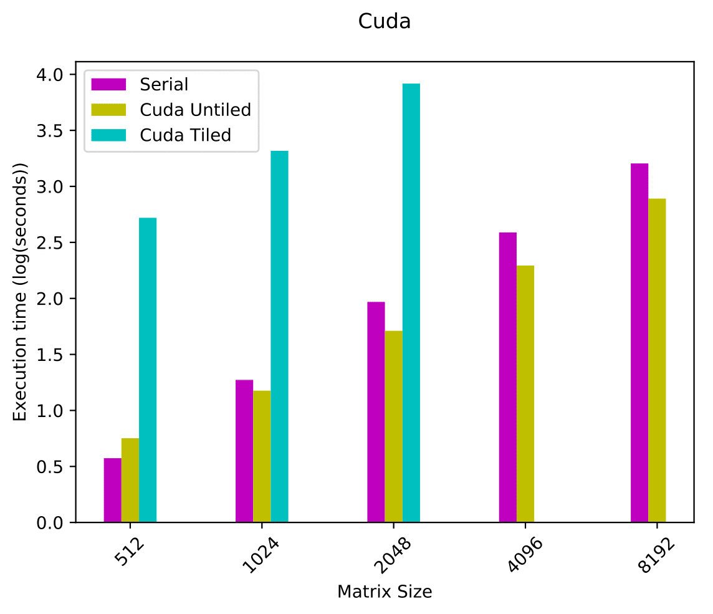
Results

Slide 21
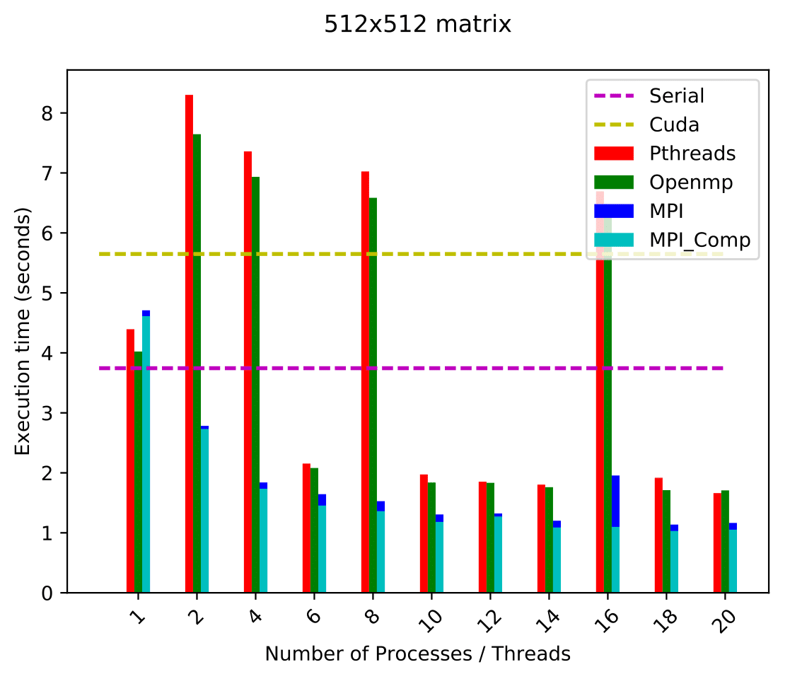
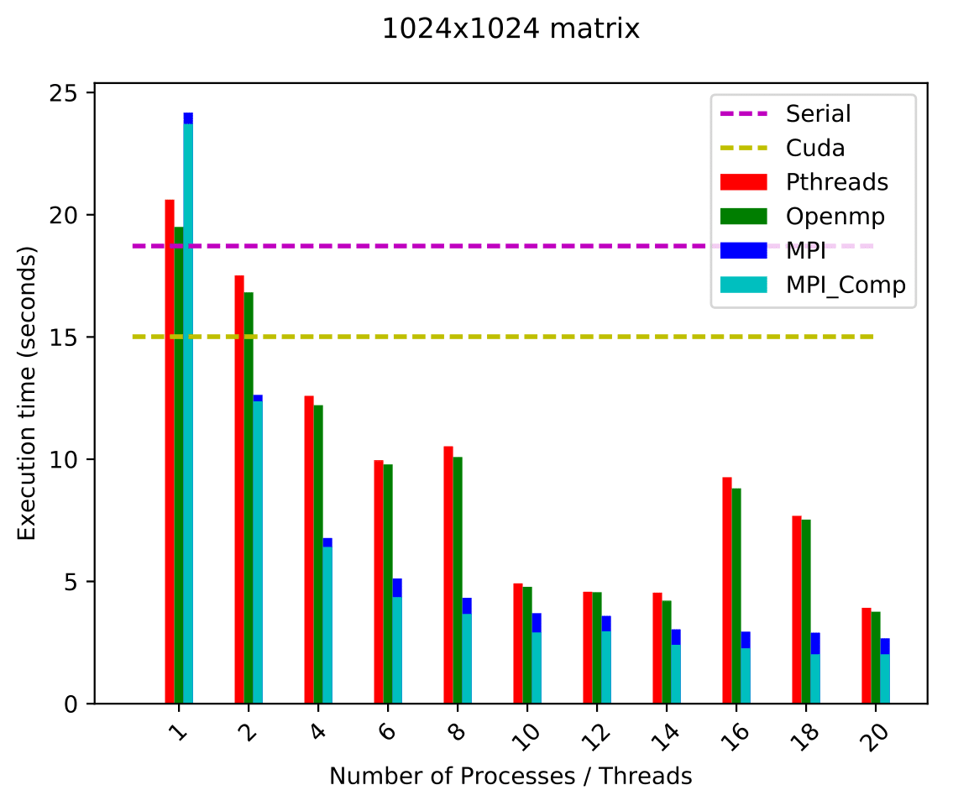
Results

Slide 22
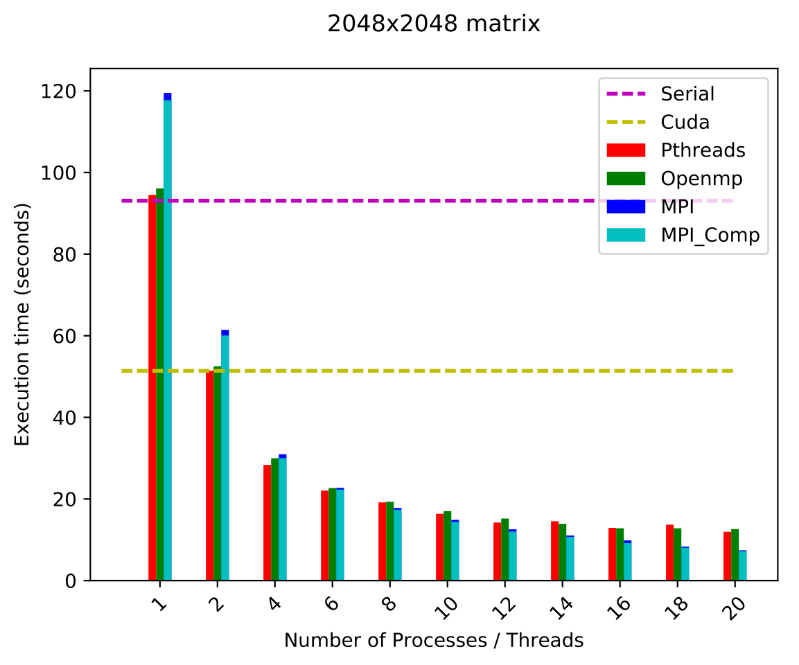
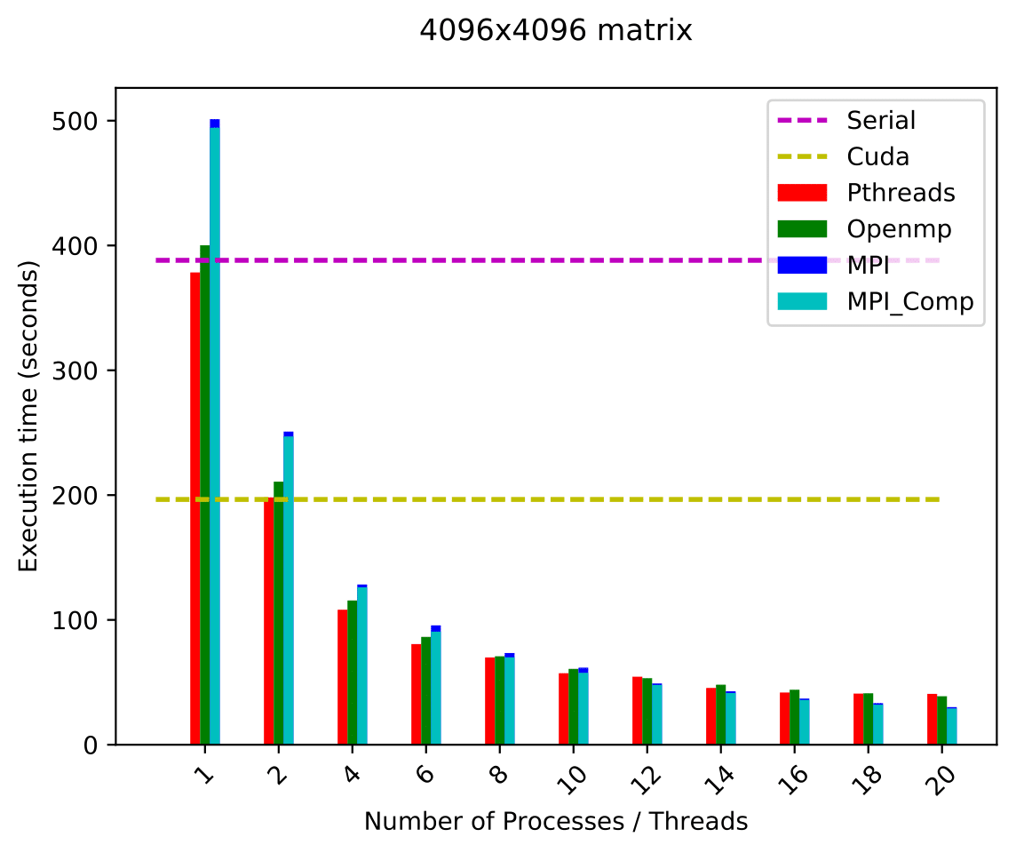
Results

Slide 23
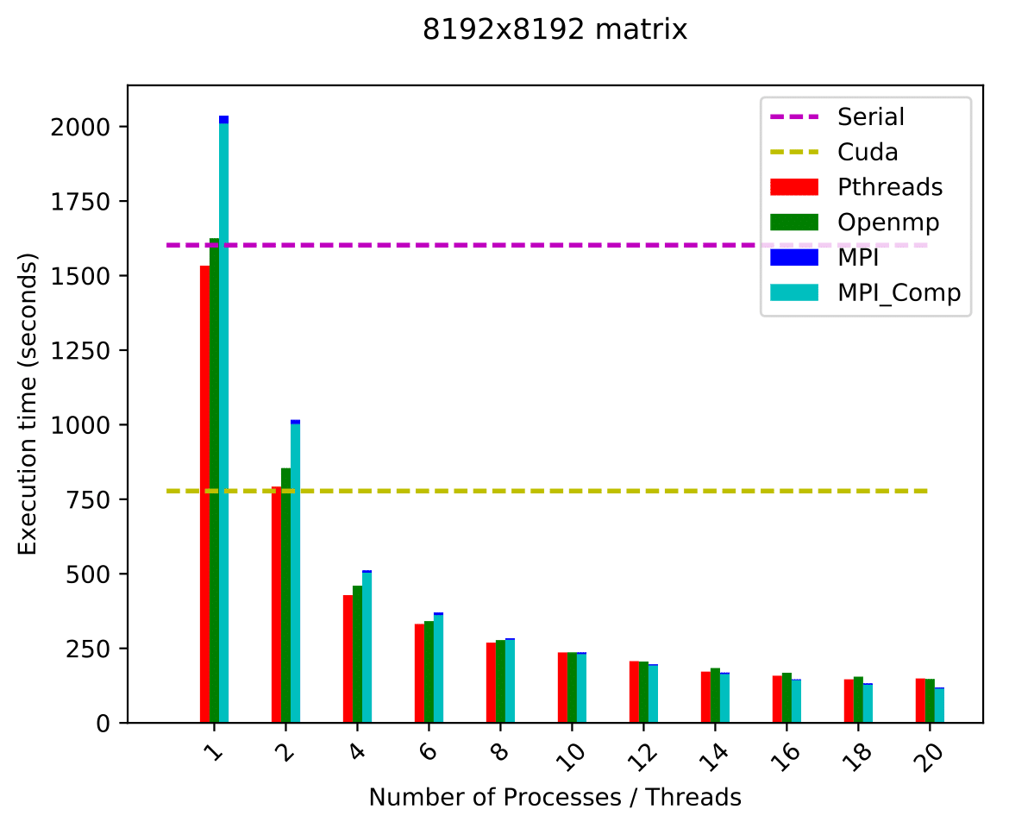
Results

Slide 24
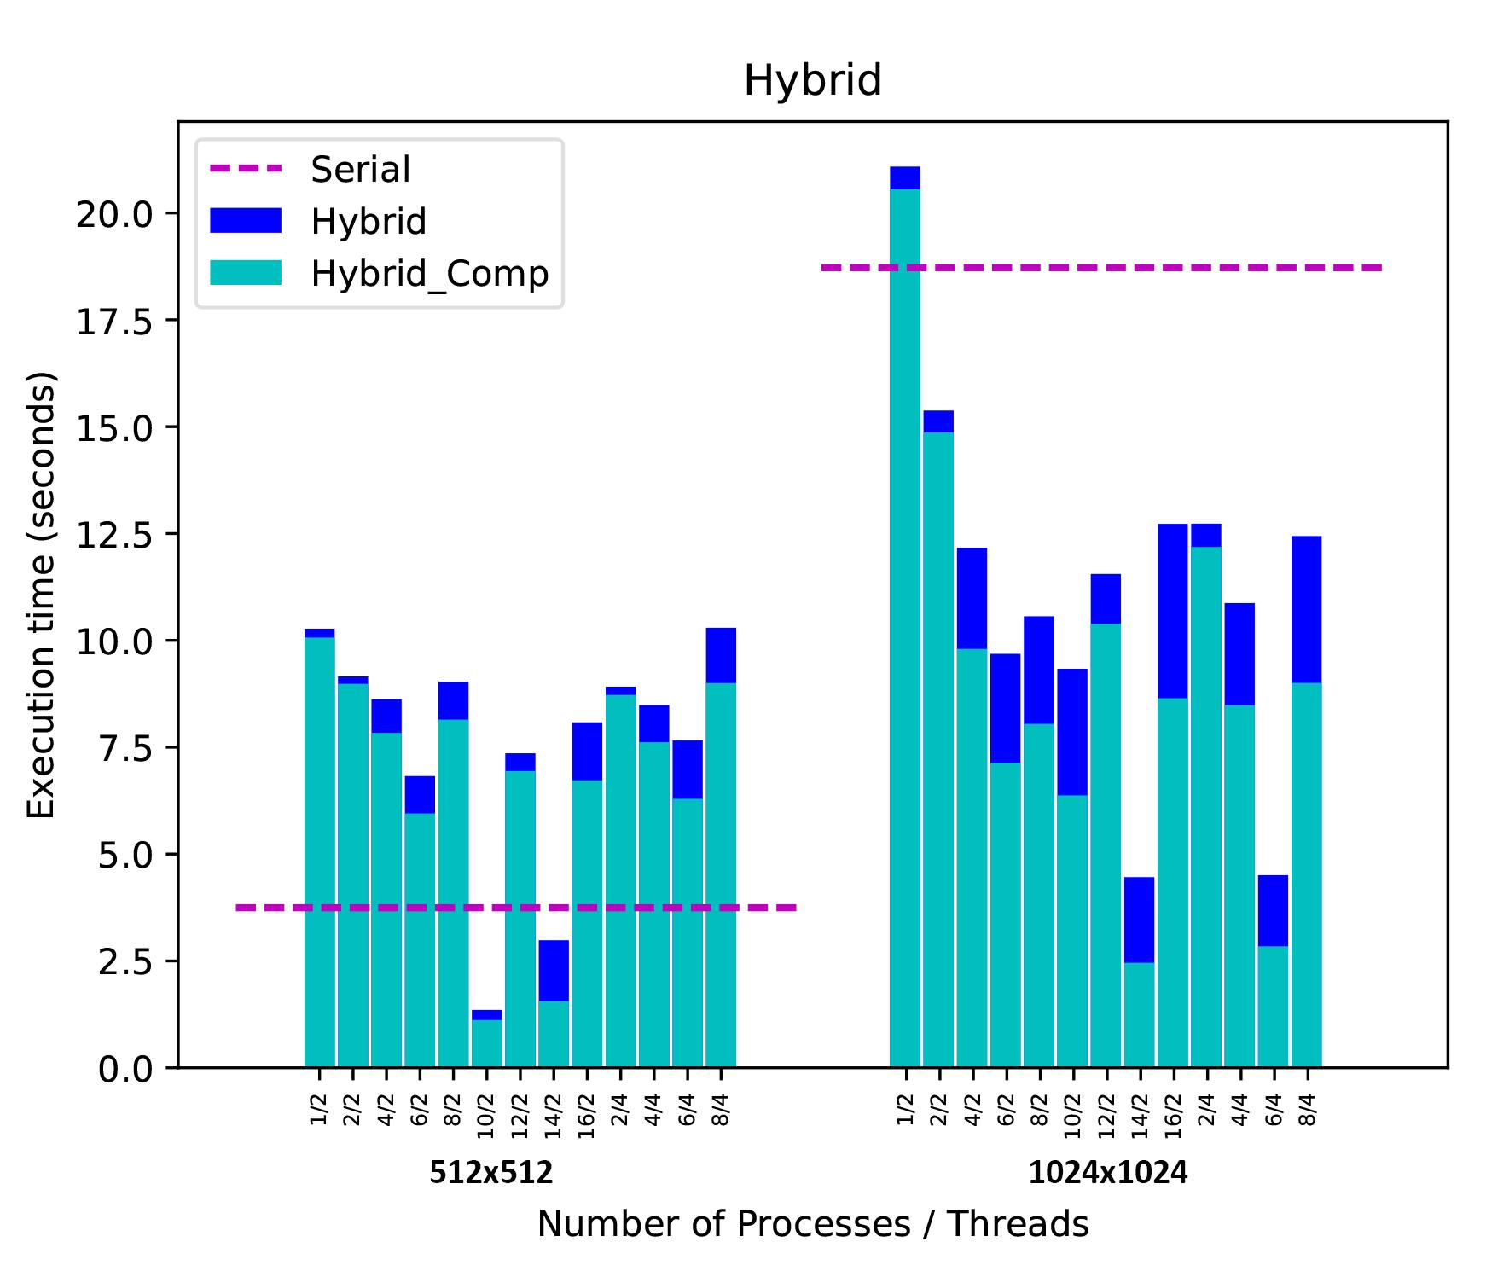
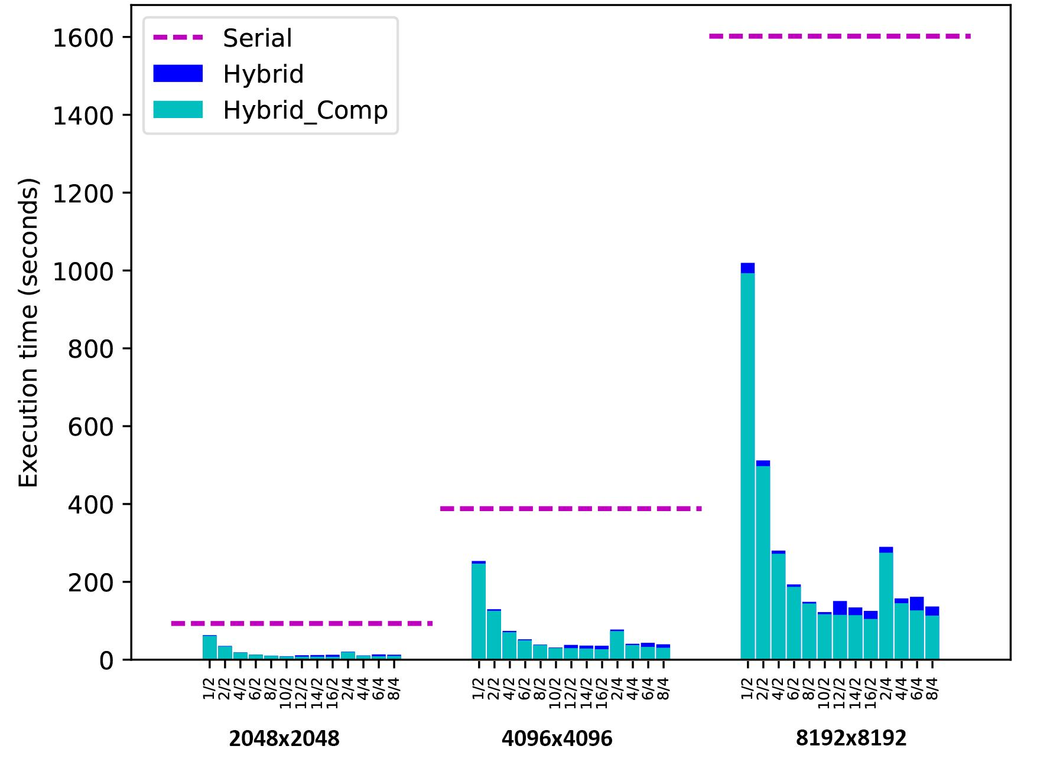
Results

Slide 25
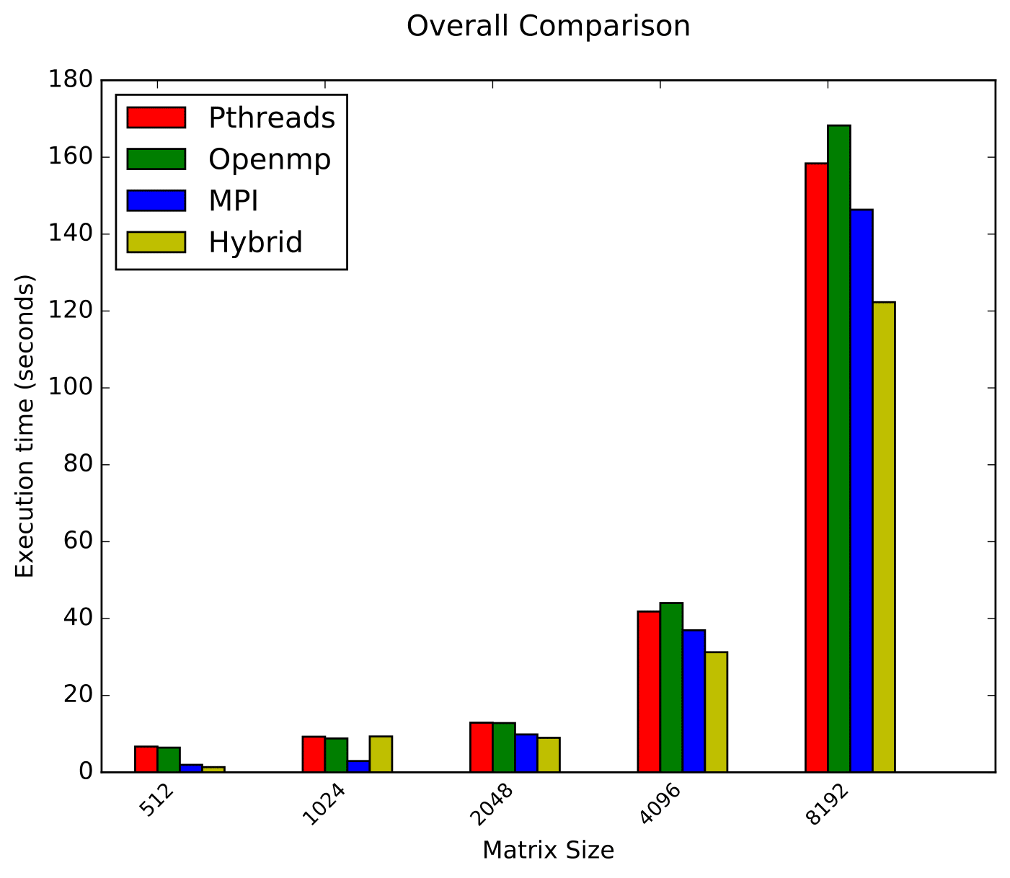
Results

